Slide 1
Assessment Of Flood Risk At Highways

Slide 2
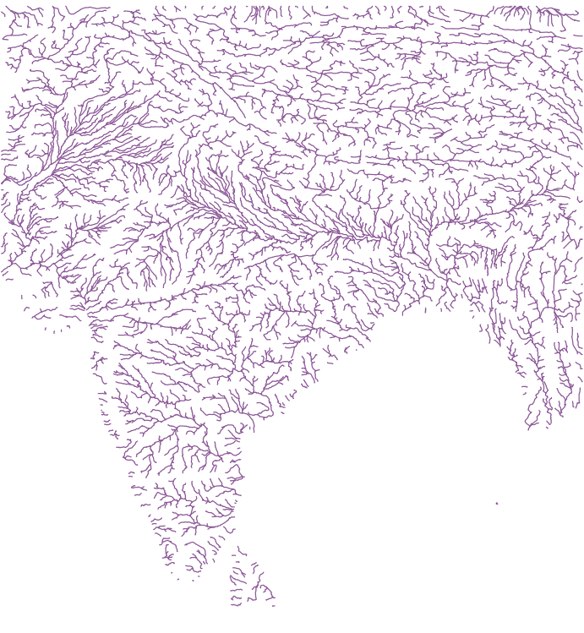
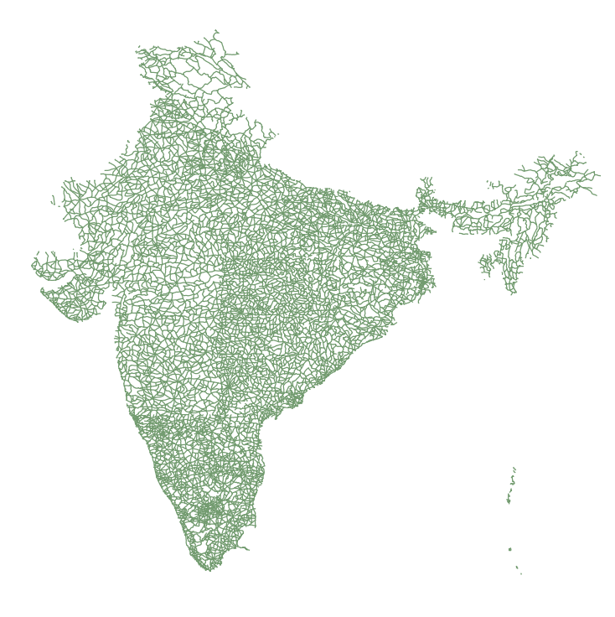
India Stream Line
Indian Road Network

Slide 3
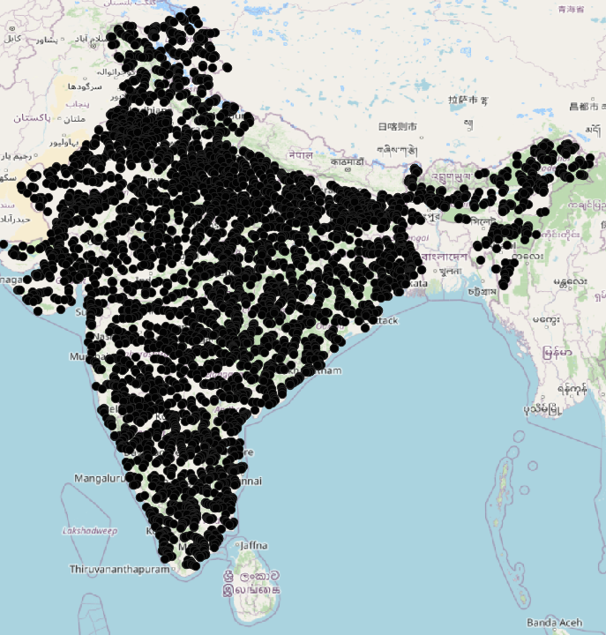
Intersection Points 5234 Intersection Points
fid | Name | Long | Lat
1 | Name1 | 77.74569328 | 35.29597339
2 | Name2 | 77.96389671 | 35.37223004
3 | Name3 | 77.99226019 | 34.97083333
4 | Name4 | 77.9420994 | 34.96623393
5 | Name5 | 77.87319281 | 34.99583333
6 | Name6 | 77.86736006 | 34.9993066
7 | Name7 | 78.00246521 | 34.96420146
8 | Name8 | 78.00508279 | 34.9625
9 | Name9 | 78.02916667 | 34.94115125
10 | Name10 | 78.16870069 | 34.76036735
11 | Name11 | 76.12145862 | 34.60479195
12 | Name12 | 77.4625 | 34.90614699
13 | Name13 | 77.47916667 | 34.87813008
14 | Name14 | 77.47252693 | 34.8858064
15 | Name15 | 77.47083333 | 34.88924203
16 | Name16 | 77.46442527 | 34.90224139
17 | Name17 | 77.3875 | 34.98263495
18 | Name18 | 77.39705034 | 34.96961633
19 | Name19 | 77.28532696 | 35.09583333

Slide 4
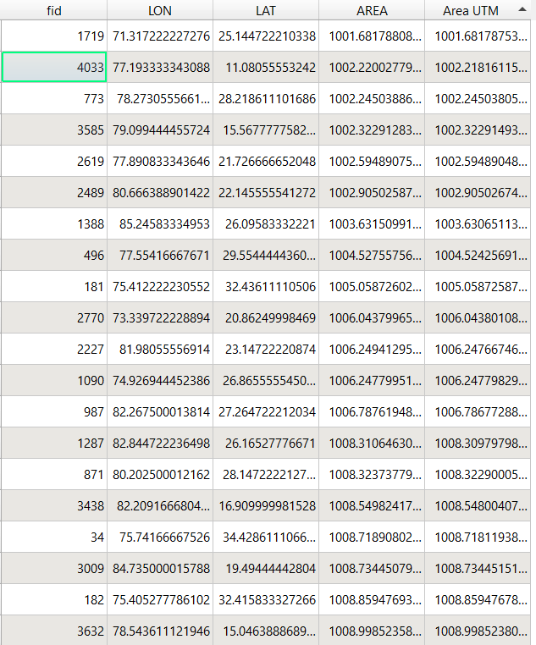
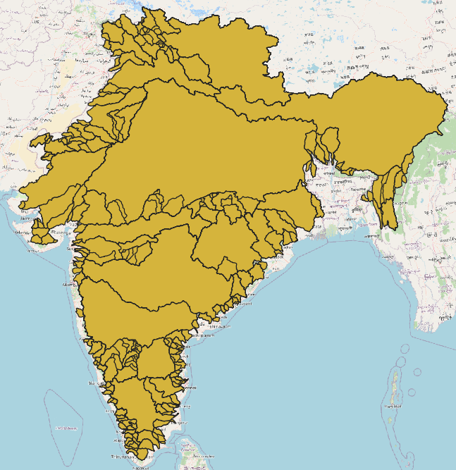
Catchment Area At All Intersection Points

Slide 5
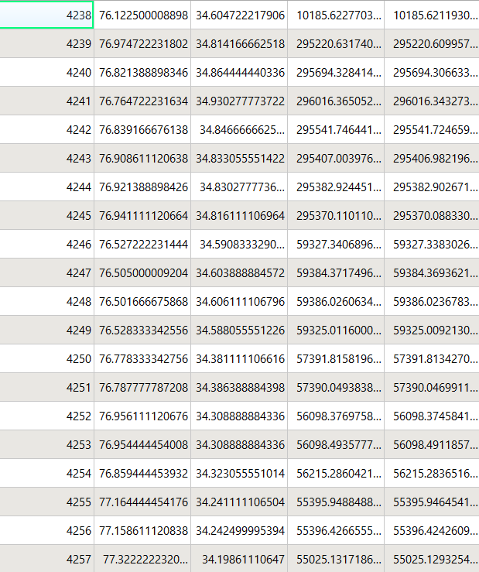
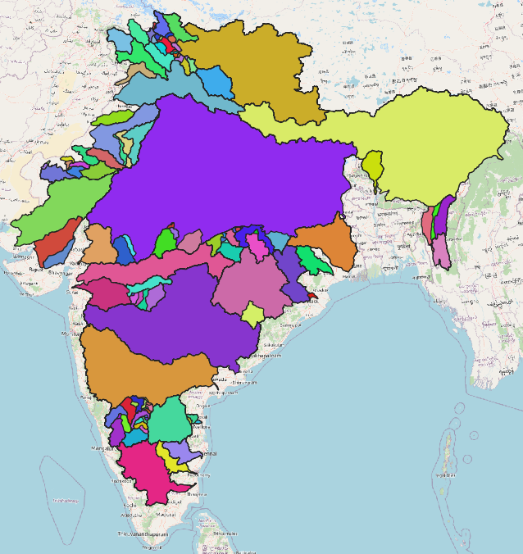
Catchments ( Area greater then 10000km^2) 903 Catchment Areas

Slide 6
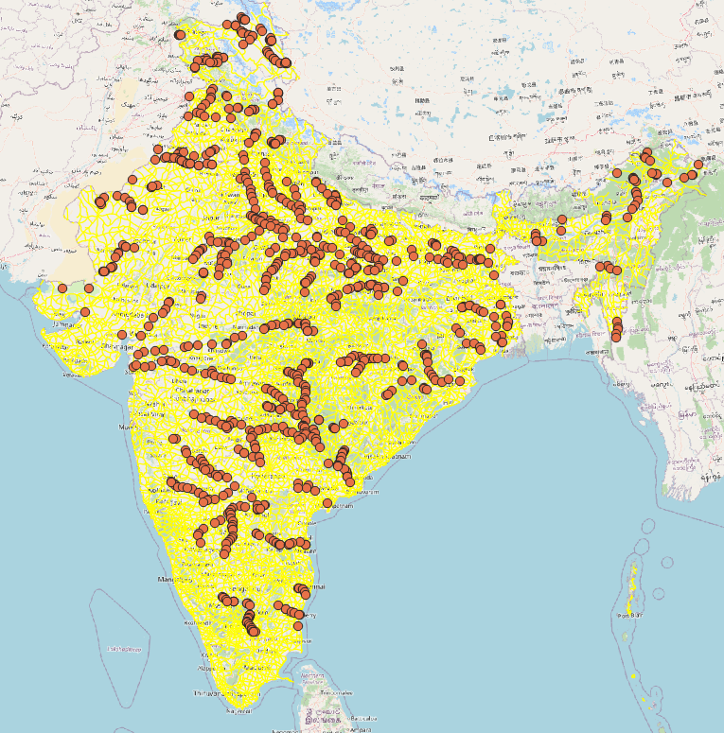
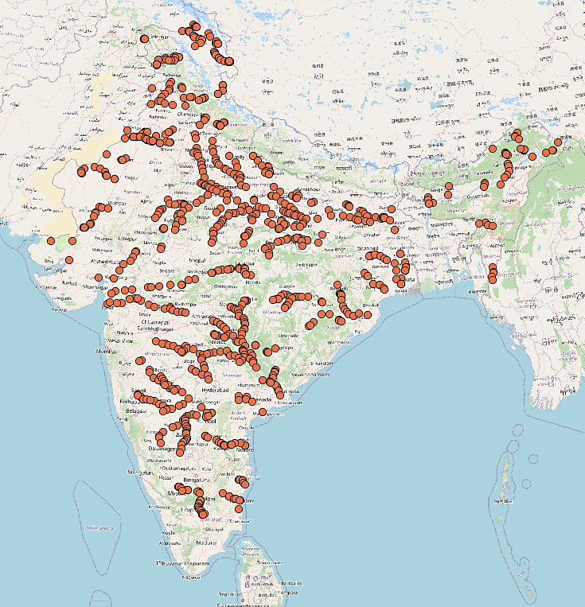
Catchments Outlet Points ( For Area Of Catchments is greater then 10000km^2) 903 Catchment Areas

Slide 7
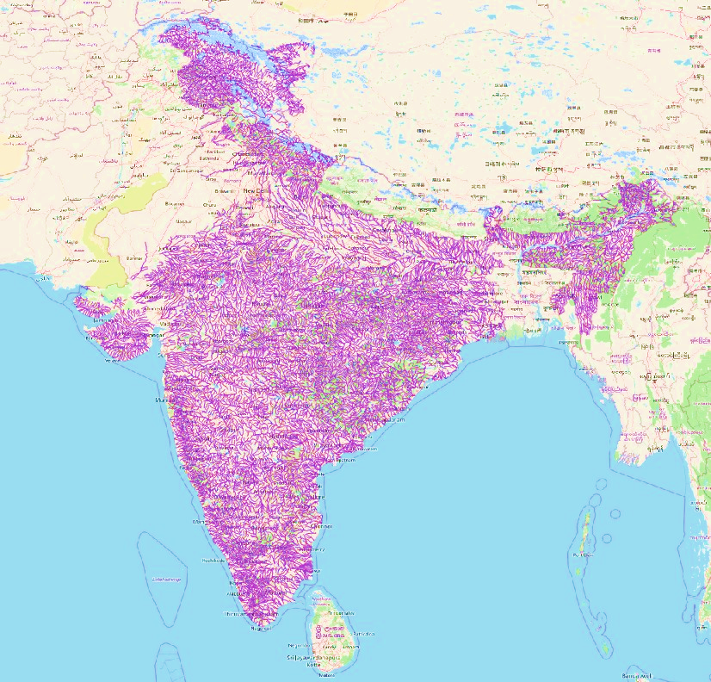
Pre-processing Of Intersection Points Shape File(Indian Rivers)

Slide 8
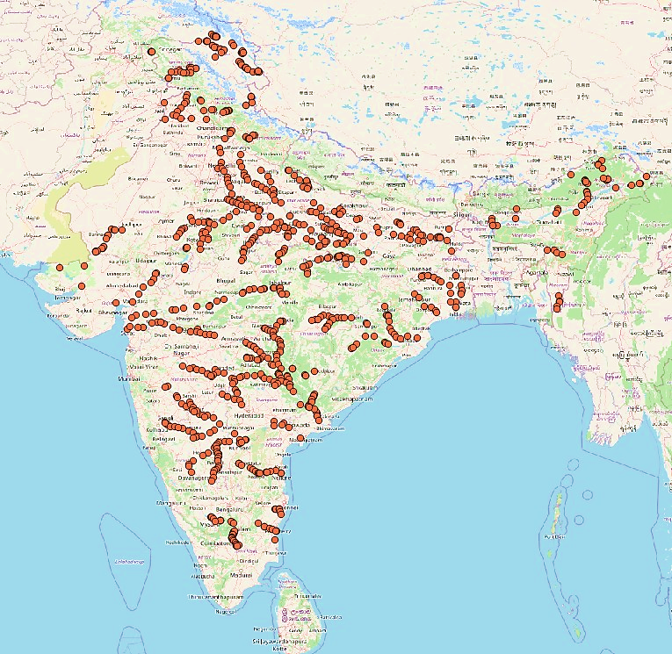
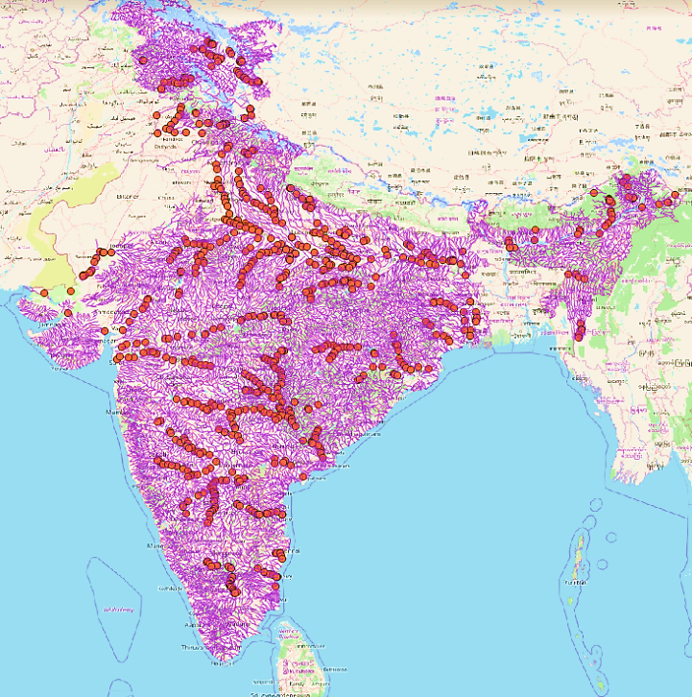
Intersection Points After Pre-processing ( For Area Of Catchments is greater then 10000km^2) 833 Catchment Areas

Slide 9
Catchment ID 4238 Points exist in catchment ID 4238
Latitude | Longitude
34.125 | 75.875
34.125 | 76.125
34.125 | 76.375
34.375 | 76.375
34.375 | 76.125
34.375 | 75.875
34.375 | 75.625
34.625 | 75.625
34.875 | 75.625
34.625 | 75.875
34.875 | 75.875
34.625 | 75.375
34.875 | 75.375
35.125 | 75.375
fid | Latitude | Longitude | fid_2 | LON | LAT | AREA | Area UTM
1 | 34.125 | 75.875 | 4238 | 76.12250001 | 34.60472222 | 10185.62277 | 10185.62119
2 | 34.125 | 76.125 | 4238 | 76.12250001 | 34.60472222 | 10185.62277 | 10185.62119
3 | 34.125 | 76.375 | 4238 | 76.12250001 | 34.60472222 | 10185.62277 | 10185.62119
4 | 34.375 | 76.375 | 4238 | 76.12250001 | 34.60472222 | 10185.62277 | 10185.62119
5 | 34.375 | 76.125 | 4238 | 76.12250001 | 34.60472222 | 10185.62277 | 10185.62119
6 | 34.375 | 75.875 | 4238 | 76.12250001 | 34.60472222 | 10185.62277 | 10185.62119
7 | 34.375 | 75.625 | 4238 | 76.12250001 | 34.60472222 | 10185.62277 | 10185.62119
8 | 34.625 | 75.625 | 4238 | 76.12250001 | 34.60472222 | 10185.62277 | 10185.62119
9 | 34.875 | 75.625 | 4238 | 76.12250001 | 34.60472222 | 10185.62277 | 10185.62119
10 | 34.625 | 75.875 | 4238 | 76.12250001 | 34.60472222 | 10185.62277 | 10185.62119
11 | 34.875 | 75.875 | 4238 | 76.12250001 | 34.60472222 | 10185.62277 | 10185.62119
12 | 34.625 | 75.375 | 4238 | 76.12250001 | 34.60472222 | 10185.62277 | 10185.62119
13 | 34.875 | 75.375 | 4238 | 76.12250001 | 34.60472222 | 10185.62277 | 10185.62119
14 | 35.125 | 75.375 | 4238 | 76.12250001 | 34.60472222 | 10185.62277 | 10185.62119

Slide 10
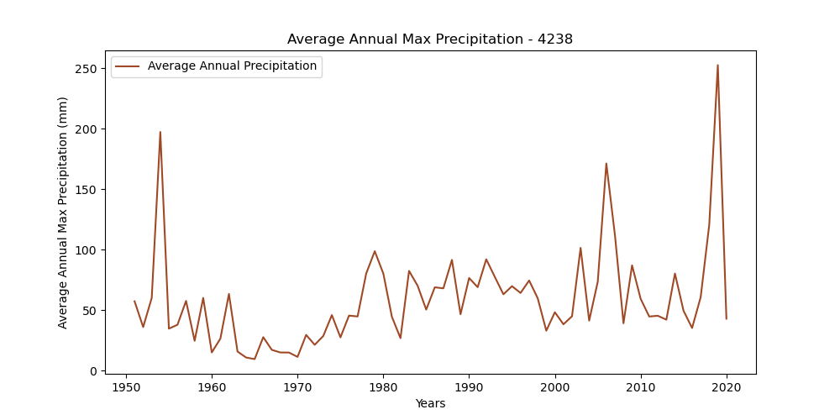
Trend Analysis For Catchment ID 4238
Max Value: 252.73
Mean Value: 58.78
Standard Deviation: 40.91
Covariance Matrix:
1697.6780991023556

Slide 11
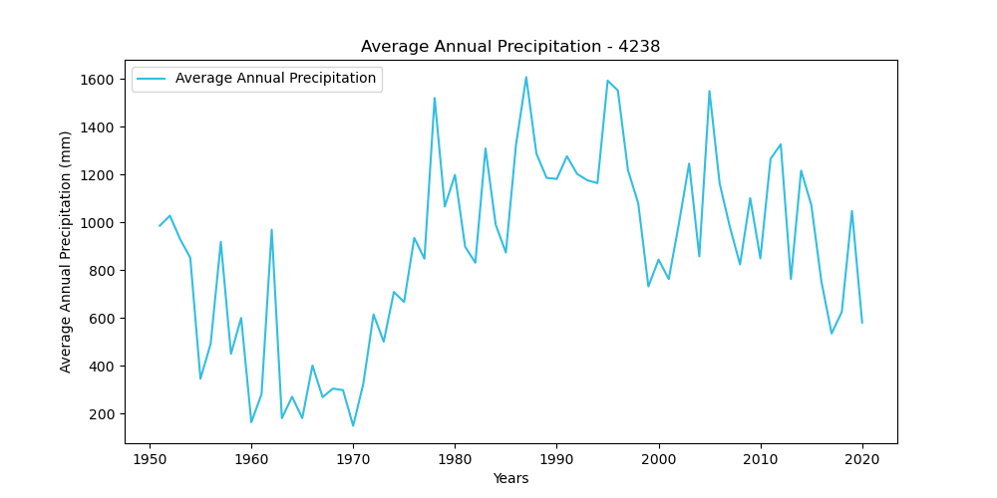
Trend Analysis For Catchment ID 4238
Max Value: 1608.03
Mean Value: 876.27
Standard Deviation: 384.52
Covariance Matrix:
149999.67624803673

Slide 12
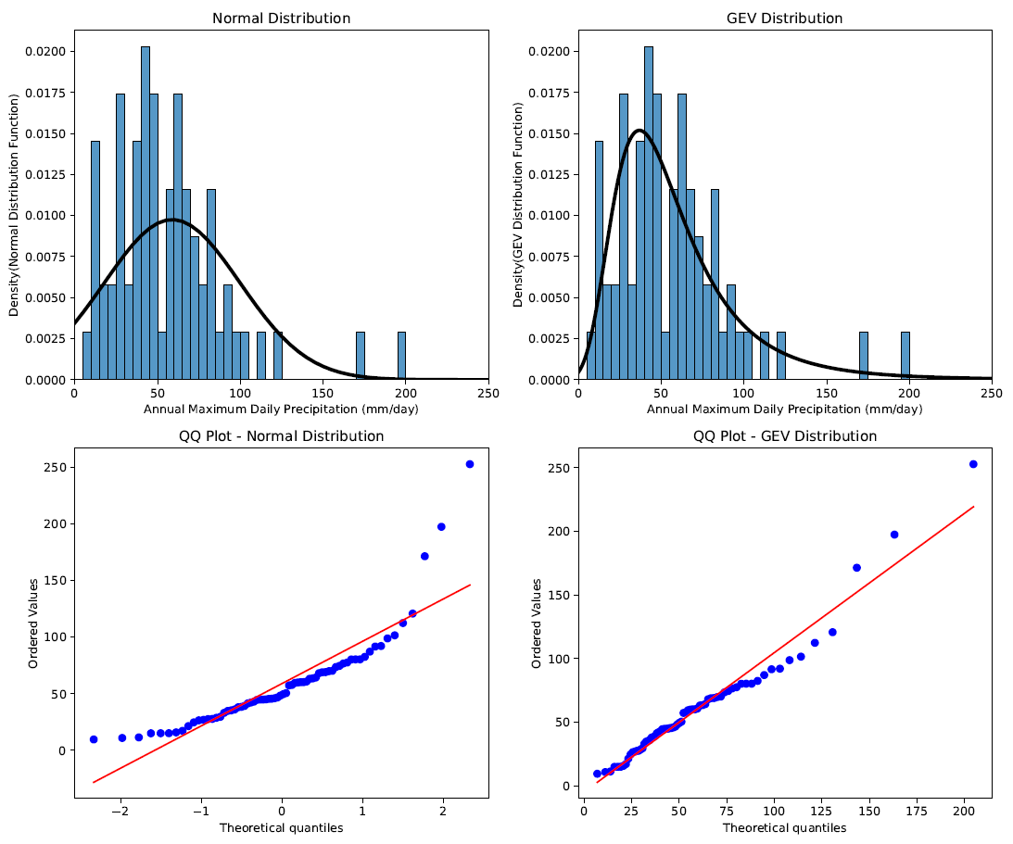
GEV Model On Catchment ID 4238

Slide 13
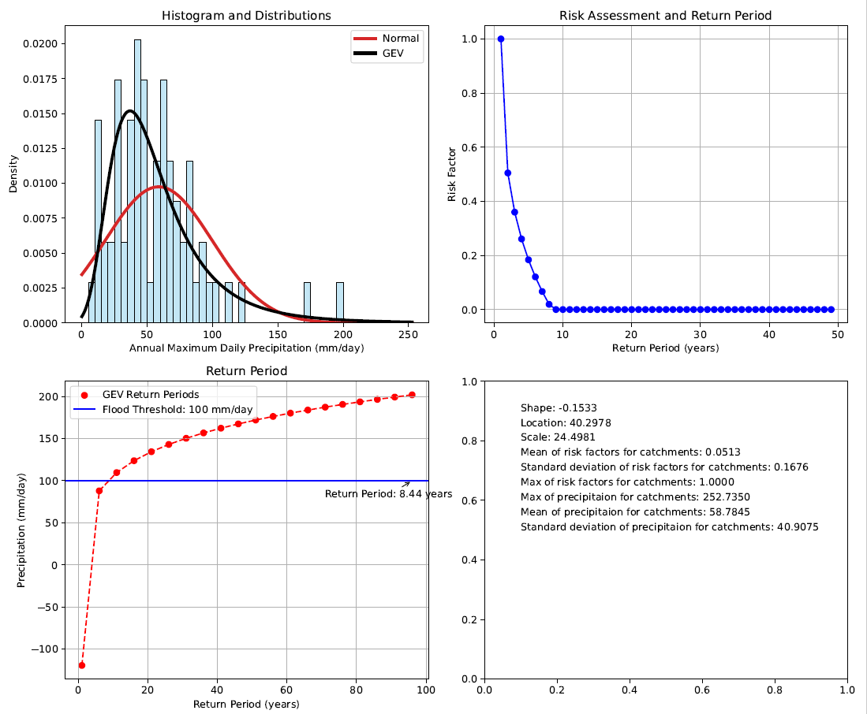

Slide 14
Design Precipitation For Corresponding Return Periods (1951-2014)
Catchment ID | Latitude | Longitude | Return Period 25 | Return Period 30 | Return Period 35 | Return Period 40 | Return Period 45 | Return Period 50
4238 | 34.60472 | 76.1225 | 35.55968 | 36.27943 | 36.8826 | 37.40134 | 37.85616 | 38.26091
4239 | 34.81417 | 76.97472 | 37.40104 | 38.6735 | 39.75902 | 40.70689 | 41.54902 | 42.3073
4240 | 34.86444 | 76.82139 | 37.22063 | 38.50381 | 39.59993 | 40.55814 | 41.41032 | 42.17831
4241 | 34.93028 | 76.76472 | 37.22063 | 38.50381 | 39.59993 | 40.55814 | 41.41032 | 42.17831
4242 | 34.84667 | 76.83917 | 37.22063 | 38.50381 | 39.59993 | 40.55814 | 41.41032 | 42.17831
4243 | 34.83306 | 76.90861 | 37.40104 | 38.6735 | 39.75902 | 40.70689 | 41.54902 | 42.3073
4244 | 34.83028 | 76.92139 | 37.40104 | 38.6735 | 39.75902 | 40.70689 | 41.54902 | 42.3073
4245 | 34.81611 | 76.94111 | 37.40104 | 38.6735 | 39.75902 | 40.70689 | 41.54902 | 42.3073
4246 | 34.59083 | 76.52722 | 30.34663 | 31.15857 | 31.85349 | 32.462 | 33.00394 | 33.49297
4247 | 34.60389 | 76.505 | 30.34663 | 31.15857 | 31.85349 | 32.462 | 33.00394 | 33.49297
4248 | 34.60611 | 76.50167 | 30.34663 | 31.15857 | 31.85349 | 32.462 | 33.00394 | 33.49297
4249 | 34.58806 | 76.52833 | 30.34663 | 31.15857 | 31.85349 | 32.462 | 33.00394 | 33.49297
4250 | 34.38111 | 76.77833 | 30.46326 | 31.26849 | 31.95639 | 32.55778 | 33.09266 | 33.57472
4251 | 34.38639 | 76.78778 | 30.46326 | 31.26849 | 31.95639 | 32.55778 | 33.09266 | 33.57472
4252 | 34.30889 | 76.95611 | 30.2456 | 31.01057 | 31.66202 | 32.23002 | 32.734 | 33.18728
4253 | 34.30889 | 76.95444 | 30.2456 | 31.01057 | 31.66202 | 32.23002 | 32.734 | 33.18728
4254 | 34.32306 | 76.85944 | 30.2456 | 31.01057 | 31.66202 | 32.23002 | 32.734 | 33.18728
4255 | 34.24111 | 77.16444 | 29.91646 | 30.63905 | 31.25269 | 31.78646 | 32.25909 | 32.68339
4256 | 34.2425 | 77.15861 | 29.91646 | 30.63905 | 31.25269 | 31.78646 | 32.25909 | 32.68339

Slide 15
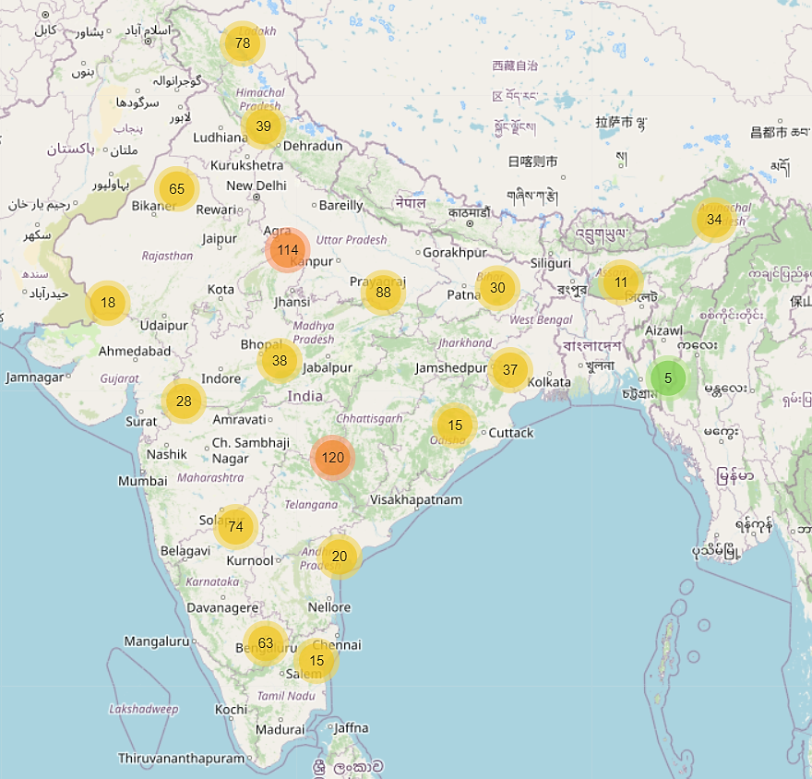

Slide 16
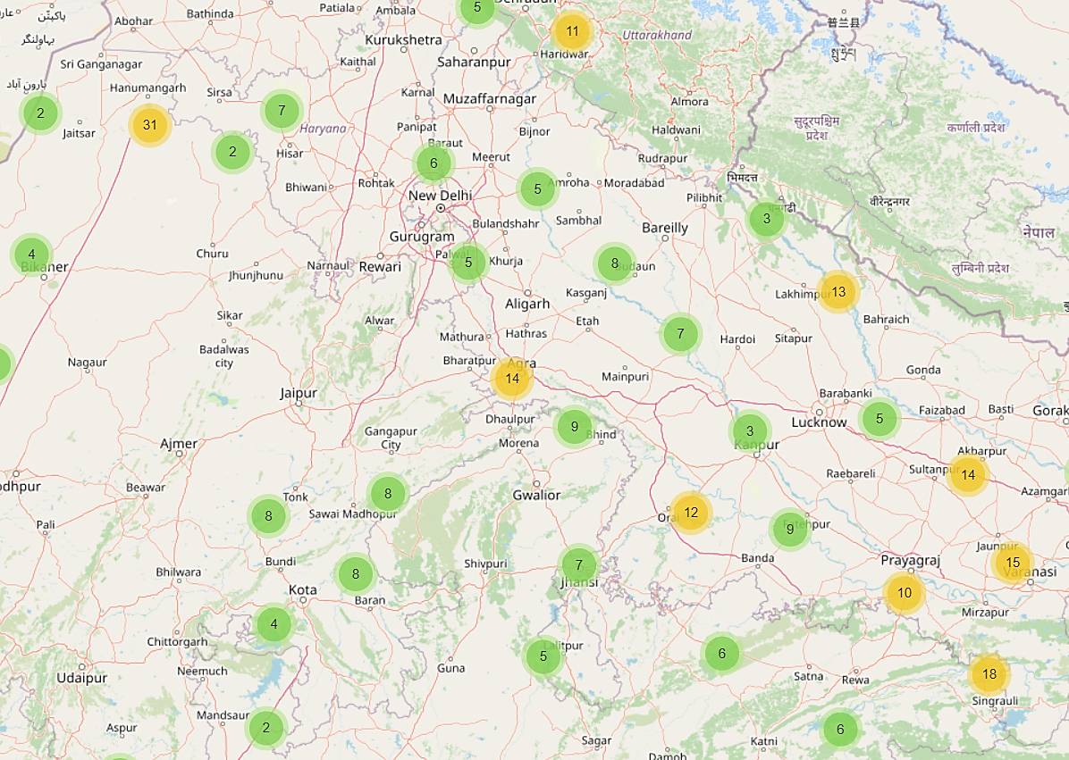
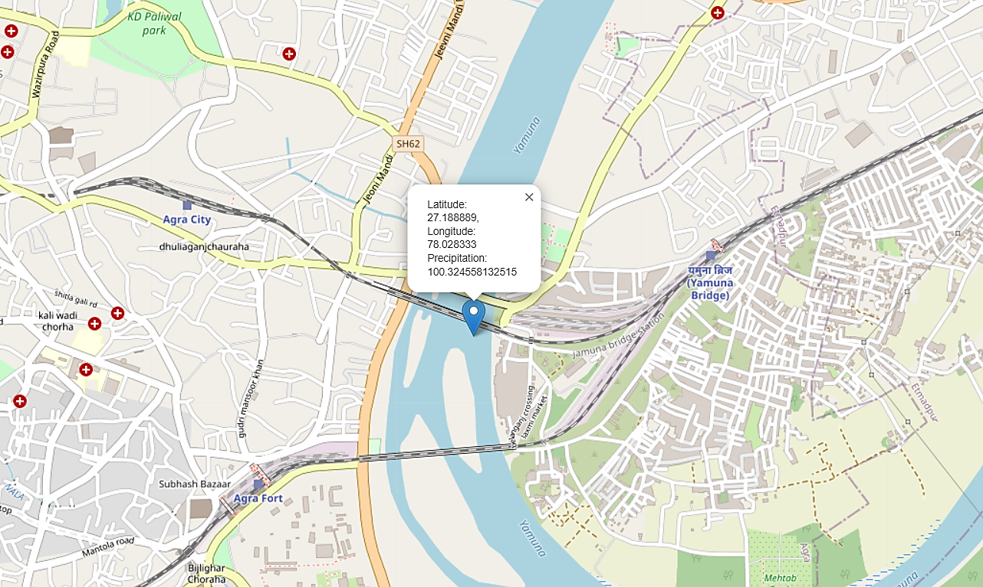

Slide 17
Return Period Prediction Using Design Precipitation (For Future Data ssp126 (increase in temp 1.5 Degree Celsius)
Catchment ID | Latitude | Longitude | Return Period 25 | Return Period 30 | Return Period 35 | Return Period 40 | Return Period 45 | Return Period 50
4238 | 34.60472 | 76.12250001 | 26.27125722 | 26.2683219 | 26.26595026 | 26.26397175 | 26.26228167 | 26.26081144
4246 | 34.59083 | 76.52722223 | 20.21301839 | 20.20991735 | 20.20738879 | 20.20526358 | 20.20343682 | 20.20183914
4247 | 34.60389 | 76.50500001 | 20.21301839 | 20.20991735 | 20.20738879 | 20.20526358 | 20.20343682 | 20.20183914
4248 | 34.60611 | 76.50166668 | 20.21301839 | 20.20991735 | 20.20738879 | 20.20526358 | 20.20343682 | 20.20183914
4249 | 34.58806 | 76.52833334 | 20.21301839 | 20.20991735 | 20.20738879 | 20.20526358 | 20.20343682 | 20.20183914
4250 | 34.38111 | 76.77833334 | 20.1177344 | 20.11467402 | 20.11218173 | 20.11008913 | 20.10829191 | 20.10672121
4251 | 34.38639 | 76.78777779 | 20.1177344 | 20.11467402 | 20.11218173 | 20.11008913 | 20.10829191 | 20.10672121
4252 | 34.30889 | 76.95611112 | 20.09407267 | 20.09112252 | 20.08872257 | 20.08670923 | 20.0849813 | 20.08347204
4253 | 34.30889 | 76.95444445 | 20.09407267 | 20.09112252 | 20.08872257 | 20.08670923 | 20.0849813 | 20.08347204
4254 | 34.32306 | 76.85944445 | 20.09407267 | 20.09112252 | 20.08872257 | 20.08670923 | 20.0849813 | 20.08347204
4255 | 34.24111 | 77.16444445 | 20.07443318 | 20.07159072 | 20.06928003 | 20.06734268 | 20.06568073 | 20.06422969
4256 | 34.2425 | 77.15861112 | 20.07443318 | 20.07159072 | 20.06928003 | 20.06734268 | 20.06568073 | 20.06422969
4257 | 34.19861 | 77.32222223 | 20.07443318 | 20.07159072 | 20.06928003 | 20.06734268 | 20.06568073 | 20.06422969
4258 | 34.19833 | 77.3213889 | 20.07443318 | 20.07159072 | 20.06928003 | 20.06734268 | 20.06568073 | 20.06422969

Slide 18
Return Period Prediction Using Design Precipitation (For Future Data ssp245 (increase in temp 2.5 Degree Celsius)
Catchment ID | Latitude | Longitude | Return Period 25 | Return Period 30 | Return Period 35 | Return Period 40 | Return Period 45 | Return Period 50
4238 | 34.60472 | 76.1225 | 28.66854 | 28.66485 | 28.66187 | 28.65938 | 28.65725 | 28.6554
4246 | 34.59083 | 76.52722 | 22.48563 | 22.48165 | 22.47841 | 22.47569 | 22.47335 | 22.47131
4247 | 34.60389 | 76.505 | 22.48563 | 22.48165 | 22.47841 | 22.47569 | 22.47335 | 22.47131
4248 | 34.60611 | 76.50167 | 22.48563 | 22.48165 | 22.47841 | 22.47569 | 22.47335 | 22.47131
4249 | 34.58806 | 76.52833 | 22.48563 | 22.48165 | 22.47841 | 22.47569 | 22.47335 | 22.47131
4250 | 34.38111 | 76.77833 | 22.43352 | 22.42956 | 22.42632 | 22.42361 | 22.42128 | 22.41924
4251 | 34.38639 | 76.78778 | 22.43352 | 22.42956 | 22.42632 | 22.42361 | 22.42128 | 22.41924
4252 | 34.30889 | 76.95611 | 22.43002 | 22.42619 | 22.42308 | 22.42047 | 22.41822 | 22.41627
4253 | 34.30889 | 76.95444 | 22.43002 | 22.42619 | 22.42308 | 22.42047 | 22.41822 | 22.41627
4254 | 34.32306 | 76.85944 | 22.43002 | 22.42619 | 22.42308 | 22.42047 | 22.41822 | 22.41627
4255 | 34.24111 | 77.16444 | 22.42939 | 22.42571 | 22.42272 | 22.42021 | 22.41805 | 22.41617
4256 | 34.2425 | 77.15861 | 22.42939 | 22.42571 | 22.42272 | 22.42021 | 22.41805 | 22.41617
4257 | 34.19861 | 77.32222 | 22.42939 | 22.42571 | 22.42272 | 22.42021 | 22.41805 | 22.41617
4258 | 34.19833 | 77.32139 | 22.42939 | 22.42571 | 22.42272 | 22.42021 | 22.41805 | 22.41617

Slide 19
Return Period Prediction Using Design Precipitation (For Future Data ssp370 (increase in temp 3.5 Degree Celsius)
Catchment ID | Latitude | Longitude | Return Period 25 | Return Period 30 | Return Period 35 | Return Period 40 | Return Period 45 | Return Period 50
4238 | 34.60472 | 76.1225 | 28.10331 | 28.09938 | 28.0962 | 28.09356 | 28.09129 | 28.08933
4246 | 34.59083 | 76.52722 | 21.49008 | 21.48649 | 21.48355 | 21.48109 | 21.47897 | 21.47712
4247 | 34.60389 | 76.505 | 21.49008 | 21.48649 | 21.48355 | 21.48109 | 21.47897 | 21.47712
4248 | 34.60611 | 76.50167 | 21.49008 | 21.48649 | 21.48355 | 21.48109 | 21.47897 | 21.47712
4249 | 34.58806 | 76.52833 | 21.49008 | 21.48649 | 21.48355 | 21.48109 | 21.47897 | 21.47712
4250 | 34.38111 | 76.77833 | 21.44423 | 21.44069 | 21.4378 | 21.43538 | 21.4333 | 21.43148
4251 | 34.38639 | 76.78778 | 21.44423 | 21.44069 | 21.4378 | 21.43538 | 21.4333 | 21.43148
4252 | 34.30889 | 76.95611 | 21.44636 | 21.44293 | 21.44014 | 21.4378 | 21.43579 | 21.43404
4253 | 34.30889 | 76.95444 | 21.44636 | 21.44293 | 21.44014 | 21.4378 | 21.43579 | 21.43404
4254 | 34.32306 | 76.85944 | 21.44636 | 21.44293 | 21.44014 | 21.4378 | 21.43579 | 21.43404
4255 | 34.24111 | 77.16444 | 21.44725 | 21.44391 | 21.4412 | 21.43892 | 21.43697 | 21.43527
4256 | 34.2425 | 77.15861 | 21.44725 | 21.44391 | 21.4412 | 21.43892 | 21.43697 | 21.43527
4257 | 34.19861 | 77.32222 | 21.44725 | 21.44391 | 21.4412 | 21.43892 | 21.43697 | 21.43527
4258 | 34.19833 | 77.32139 | 21.44725 | 21.44391 | 21.4412 | 21.43892 | 21.43697 | 21.43527

Slide 20
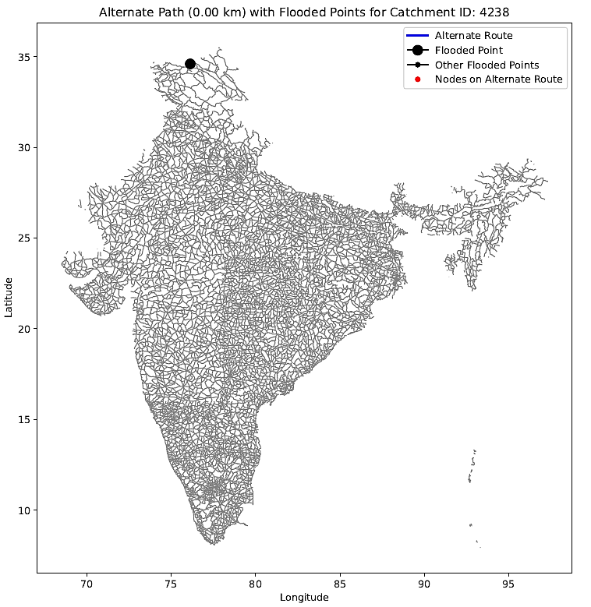
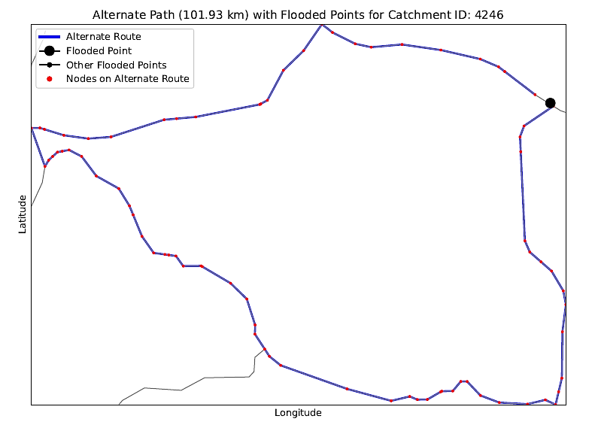
Road Network Analysis

Slide 21
Catchment Id | Alternate Route Present | Length of Alternate Route (km) | Another Flooded Point on Alternate Route
4238 | Absent | Not defined | Absent
4239 | Absent | Not defined | Absent
4240 | Absent | Not defined | Absent
4241 | Absent | Not defined | Absent
4242 | Absent | Not defined | Absent
4243 | Absent | Not defined | Absent
4244 | Absent | Not defined | Absent
4245 | Absent | Not defined | Absent
4246 | Present | 101.9291059 | Absent
4247 | Present | 100.8567957 | Absent
4248 | Present | 100.8567957 | Absent
4249 | Present | 86.83589992 | Absent
4250 | Present | 89.00323594 | Absent
4251 | Present | 88.77028121 | Absent
4252 | Present | 335.7422668 | Absent
4253 | Present | 335.7422668 | Absent
4254 | Present | 87.51878254 | Absent
4255 | Present | 68.22713451 | Absent
4256 | Present | 68.22713451 | Absent
4257 | Present | 134.5462767 | Absent
4258 | Present | 134.5462767 | Absent
4259 | Present | 81.1654304 | Absent
4260 | Present | 81.64394858 | Absent

